Slide 1
Finance Boot Camp 2023
GENERAL INTRODUCTION
General Introduction
October 2023

Slide 2
Key objectives of today
A better understanding of Investment Banking
Key products
Different business models
Internal organization
Career opportunities
1
Introduction to Market & Corporate Finance
Overview of the IB industry
Key Products
Alumni tips
A better knowledge of the enrollment process
Different types of enrollment processes
Expectations from Investment Banks
Key dates for enrollment
2
Dedicated Rooms
Interview simulations
Feedbacks and interview tips
A clear path to prepare interviews
Personality / motivation
Knowledge of the investment banking environment
Technical skills

Slide 3
Table of Content
1
Introduction to Global Banking
Introduction to Investment Banking
Q&A Session
2
3

Slide 4
1. Introduction to Global Banking

Slide 5
Global Banking & Markets Overview
Global banking & markets
Private Side
Public Side
Corporate & investment banking (M&A)
Capital markets
Markets
(sales & trading)
Capital Markets Relationship
ORIGINATION!
Work with industry groups to advise and finance corporates on capital structure considerations and balance sheet objectives
Creating and structuring the right product for the client through debt or equity instruments
Capital markets relationship
EXECUTION!
Work with Sales & Trading to distribute a debt or equity offering to institutional investors
Sales & Trading have the relationships with institutional investors who may purchase the debt or equity offering
“DCM”
Leveraged finance
“ECM”
Originate, structure, and market fixed income securities such as bonds, loans, asset-backed securities, and commercial paper for corporates
Provide leveraged loans, high-yield bonds or a combination
Work closely with financial sponsors in leveraged buyouts, recapitalisations and refinancings
Originate, structure, and execute equity & equity-linked products for corporates
Raise or sell equity for clients
Debt
Equity
Chinese Wall
From origination to execution…

Slide 6
Example: the Securities Division ?
The Example of Goldman Sachs
Securities
Investment Banking
Investment Management
Other
Description
Key Clients
Serve clients by providing them with a large and diversified range of financial products
Asset Managers
Hedge Funds
Large Companies
Other financial services providers
Product Offering
Day to day tasks
Product offering covering the whole scope of financial assets
Cash or Derivatives (Equities, Rates, Credit, Currencies & Commodities)
Pricing
Innovative ideas research
Offer liquidity to execute transactions
Risk management
Technical (trading) and analytical service
Structured products rely on 2 specific components: (i) a bond component and (ii) one/several derivative(s) with exotic (or not) risk profiles

Slide 7
How is the Securities Division Structured ?
The Example of Goldman Sachs
Sales
Traders
Strats
In charge of client relationship management
Innovative ideas research
In charge of approach strategy / Pricing
“Market markers”
Ensure market liquidity
In charge of risk management for the bank and the clients
Provide innovative quantitative and technological solutions
Work closely with Sales and Traders on market strategies for clients
Transaction structuring, innovative ideas research and analysis for clients

Slide 8
General Overview of Equity Research
The Equity Research Analyst is the expert of the bank on its sector
no one knows the sector better than him
ECM, DCM, M&A, Traders, Sales, Derivatives…rely on him to create products/services for their own clients
On a daily basis, what does an Equity Research Analyst do ?
Gives BUY or SELL recommendations on an independent basis (Chinese Wall)
For this, he builds a model forecasting future P&Ls and cash flows: he calculates a Price target
Writes investment reports to justify /explain his investment case
Offers corporate access to his clients
Gives ideas to traders and salestraders

Slide 9
2. Introduction to Investment Banking

Slide 10
Key players in Investment Banking
Pure advisory model
Investment Banking
More « market oriented » model
More « balance sheet » model

Slide 11
Overview of major players on the European market
 | French global banks |  | European banks |  | US banks |  | Pure advisory
A few examples …
Key comments | France as a key market, large teams based in Paris Very active in financing Strong expertise in Capex intensive sectors such as infrastructure and power |  | Investment banking as a key activity (with private and/or retail banking) Strong expertise in ECM and DCM Large European platforms headed through London with offices in key cities |  | Leading players with global presence Strong investment banking focus European presence through London with offices in key cities |  | Pure advisory player Strong local presence in the home market either US, London or Paris
Global banking
Pure investment banking
Industry teams in Paris
Industry teams in London or New York

Slide 12
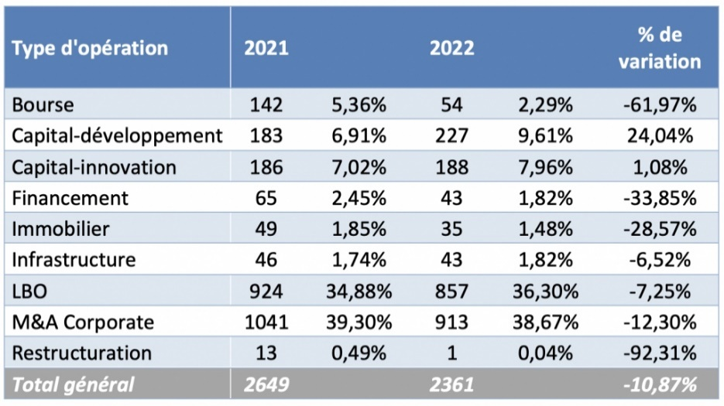
League Tables in Europe (2023)

Slide 13
Key products of the investment banking division
Investment Banking
1
2
3
Equity capital market
Products (ECM)
Financing products (DCM, LevFin)
Financial advisory
All operations related to listed equity
All operations related to debt (public or not)
Advisory related to financial transactions
Straight equity : Initial Public Offering (IPO), Rights issue, Block trades
Equity linked: Convertibles, Exchangeable
Equity derivatives
Bank loan
Leveraged products
Bonds (incl. high yield)
Private placement
Mergers & Acquisitions
Restructuring
DCM and ECM advisory
Sovereign advisory

Slide 14
Investment Banking Career Path
Different tasks and skills expected at each position
Intern
Position
Experience
Tasks
Required skills
Analyst
0 to 3 years
Information synthesis
Modelling
Production of slide for presentation
Training interns
Rigorous
Analytical
Reliable
Hard working
Associate
3 to 6 years
Training analysts and interns
Process / interactions with clients
Checking numbers
Participating in marketing effort
Pressure management
Well-organized
Multi-projects
Trainer / Recruitment
Vice-president
6 to 9 years
Guidelines on the presentation
Structuring of the transaction
Managing the team
Interactions with the client
Managing team
Communication / presentation skills
Director
9 to 12 years
Presenting
Structuring of the transaction
Generating ideas
Client relationship
“Engineer”
Relationship
Creativity
Managing Director / Partner
> 12 years
Client relationship
Generating ideas
Presenting
Creativity
Commercial

Slide 15
The Scope of Solutions Provided by ECM/SESG
Scope of solutions provided by ECM
1
Private
IPO
Rights Issue
Pre-emptive Equity Offer
Equity
Primary Issue (New Capital)
Straight Equity
Accelerated or Marketed
Non Pre-emptive Equity Offer
Financing
Public
Secondary Issue (Existing Shares)
Equity-
Linked
Convertible / Exchangeable Bonds
Debt
Share Acquisition Solutions
Financing / Stake Building
Margin Loan, Collar / Put Financing
Derivatives Strategies
Monetization / Hedging
Yield Enhancement

Slide 16
What DCM & Leveraged Finance teams do ?
2
Debt Capital Markets
Originating and executing financing mandates together with Global Markets product teams
In charge of non dilutive financing (mainly senior and hybrid bonds) for Investment Grade clients
Generally organized by issuers types : Corporate, FIG, Public, Emerging
Deals are either linked to an acquisition (acquisition loan and/or refinancing on capital markets) or made on a stand alone basis (refinancing)
Commercial Banks also have a lending activity (bank loans): Corporate Banking that can be merged with DCM
Leveraged finance
All transactions involving issuance of non-investment grade bank debt/loans, mezzanine financing or high yield bonds for corporate or sponsor clients
The purpose if issuing non-investment grade debt is typically one of the following:
Refinancing of Existing Debt to extend maturity profile (Corporate Clients)
Financing of an acquisition by a financial sponsor (Private Equity Clients)

Slide 17
Overview of financing instruments
2
Equity
No Rating
Unsecured
High Yield
Market
High Yield Bond Market
Financing
With Rating
Senior Financing
Investment Grade Market
US Market
Structured Finance
EMTN Programme
European Market
Secured
Securitisation
Standalone Issue
Debt
Project Finance
Subordinated
Debt
US Market
Hybrid Debt
Tax Products
Preferred Stock
European Market

Slide 18
What do we do in M&A ?
3
Mission statement
Deliverables for Corporate Finance
Comments
Sell-side
Help the shareholders sell the company
Rise interest of potential buyers
Maximise competition / price
Negotiate
Valuation (DCF, multiples)
Teasing investors
Selling memorandum
Due diligence (Data Room, site visits)
Negotiation
Great likelihood of completing
Privatisation, a specific kind of sell-side
Buy-side
Help your client to get the target
Convince sellers
Minimize price
Negotiate
Valuation (Business plan, DCF, …)
Review of info-memo and due diligence
Lobbying (sellers, management)
Synergies / build-up opportunities
Smaller likelihood of completing, but more profitable if done
Cross-selling opportunities
Hostile takeover
Help your client to get the target a bit more aggressively…
Confidentiality
Structuring
Maximise value with minimum price
Bid tactics & structuring
Synergies analysis and valuation (premium)
Merger model
Interlopers
Highly profitable
Cross-selling opportunities
Defence
Maximise value for shareholders
Keep the company independent?
Get a higher price from the bidder?
Get a new bidder to increase competition
Analysis of potential white knights
Merger models
Defence tactics & strategies
Lobbying
Structuring
Even if mandated by the management, the mission is not to do everything to keep the management in place
Fairness opinions
Provide an independent and expert view on the price offered by a bidder
Full valuation analysis
Valuation report with a recommendation on price
Short deadlines
100% likelihood of completing
Smaller fees but considered in league tables

Slide 19
Illustrative private asset disposal process Overview
3
Phases
Key items / Documents
Role of the investment bank
Preparation / Marketing phase
« Selling story »
Business plan
Preparing legal documents
Selecting the potential bidders
Disposal tactic
Preparing marketing documents (Teaser)
Contacting potential bidders
Reviewing the due diligence documents
Signing the Non Disclosure Agreement (NDA)
First round
Information Memorandum (document with key information on the company)
Preparing the Information Memorandum
Advising on the selection of bidders
Interacting with the bidders
Non binding letter (including non biding offer)
Second Round
Online Data Room (virtual space with comprehensive confidential information)
Management presentation
Site visits
Sales and Purchase Agreement (SPA)
Preparing the online Data Room
Preparing the Management Presentation and coaching Management
Reviewing the SPA
Interacting with the bidders
Advising on the selection of final bidders
Binding offer and mark-up on SPA
Negotiation
Final negotiation on price and SPA
Negotiation
Signing of the SPA

Slide 20
3. Q&A Session

